Slide 1

March Meltdown 2026
Family Planning Meeting
Google Meets
7:00pm
February 24, 2026

Slide 2

CIGHA Highlights
CIGHA sent THREE teams to NiHL Playoffs (10uAA,12u and 14u) GREAT JOB!
Sisters on Ice program started with 33 girls signed up! It’s not too late to join!!
https://www.cigirlshockey.com/program/sisters-on-ice/29936

Slide 3
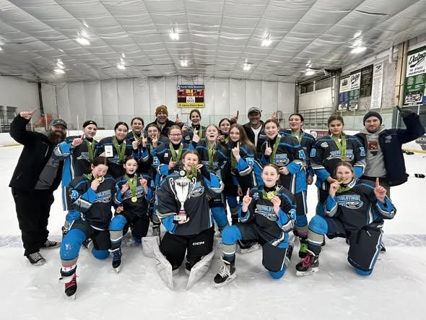
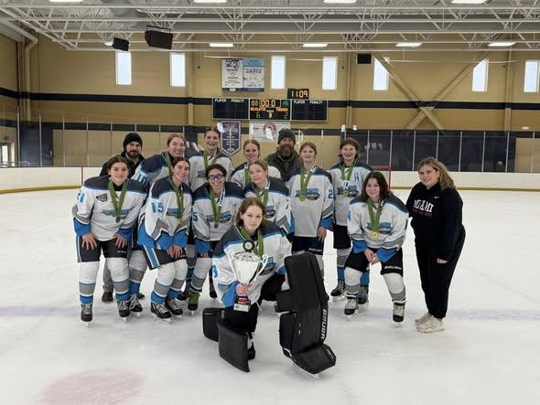
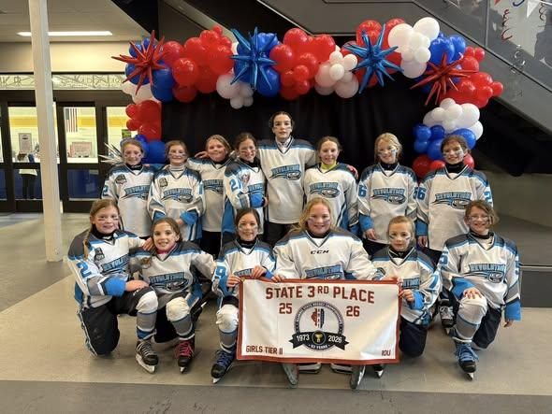
CIGHA
WEEKEND RECAP

Slide 4

Volunteer Hours Requirement
Expectation:
A MINIMUM of FOUR volunteer hours per season/per player
We need ALL hands on deck to host a successful tournament.
Consider signing up to help when your player is not on the ice.

Slide 5
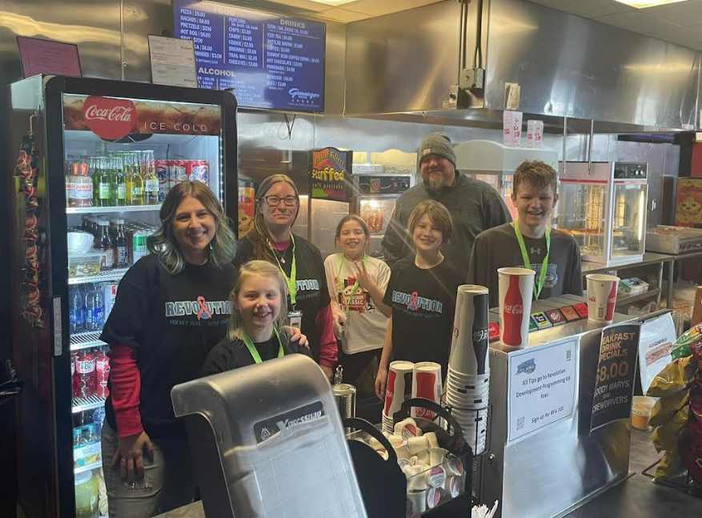
Meltdown Volunteer
Opportunities
3
Game Ops
Those that sign up for this position will be provided with a copy of the rules of the tournament as well as instructions on how to operate the clock for the game. ALL REVOLUTION TEAMS WILL BE RESPONSIBLE FOR THEIR OWN GAMES! Team Managers will handle those sign-ups separately.
SIGN-UP LINKS:
Time Clock Operators - Friday 3/7
Time Clock Operators - Saturday 3/8
Time Clock Operators - Sunday 3/9
Those that sign up for this position will be provided with a copy of the rules of the tournament as well as instructions on how to keep score for the game.
Keep score during the game. Ensure that ref’s and coach’s signatures are on the scoresheets. Make sure any hat tricks, shut-outs, playmakers are communicated so pucks can be presented to those players who earn them. ALL REVOLUTION TEAMS WILL BE RESPONSIBLE FOR THEIR OWN GAMES! Team Managers will handle those sign-ups separately.
SIGN-UP LINKS:
Scorekeeper - Friday 3/7
Scorekeeper - Saturday 3/8
Scorekeeper - Sunday 3/9
1
Set Up and Welcome Desk
2
Concessions
SIGN-UP LINK: Concession Stand Volunteers
We will be operating one concession stand throughout the tournament. To serve alcohol you must have a Basset Certification. If you do not have this certification, you cannot serve alcohol at the stand. The fee to acquire your certification is $12.95 and can be reimbursed by CIGHA.
Acquire your Illinois BASSET Certificate: https://coursesforservers.com/Courses/IllinoisBASSET Please send a copy of your certificate to Sarah at sarah.clark@cigirlshockey.com
Volunteers must be at least 16 years old to run the cash registers. Younger volunteers can assist the older volunteers at the Snack stand, they just can’t “sign up.”
SIGN-UP LINK: Set Up/Tear Down
SIGN-UP LINK: Welcome Desk

Slide 6
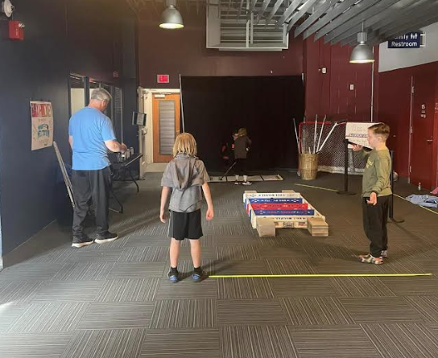
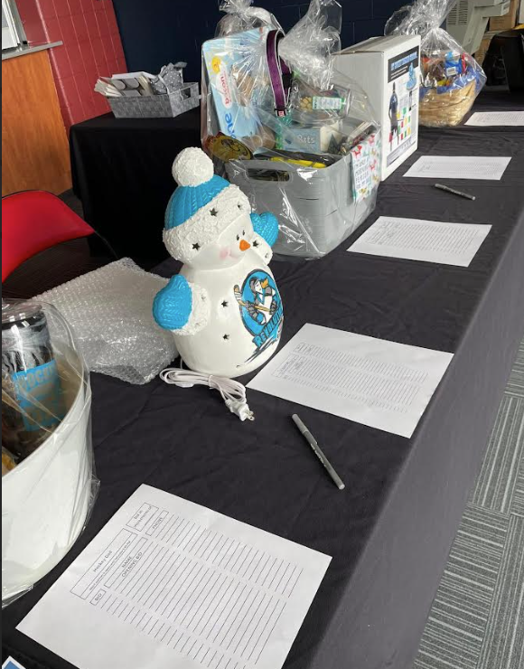
Meltdown Volunteer Opportunities
5
Jamborees Snack and Time
4
Silent Auction and Raffles
SIGN-UP LINK: Jamboree Time Clock Operator
SIGN-UP LINK: Jamboree Snack Table Volunteer
6
Game Area
SIGN-UP LINK: Silent Auction Table Volunteers
SIGN-UP LINK: Silent Auction Basket Sign Up
Please let Natalie Rayfield know if you have any questions: secretary@cigirlshockey.com.
SIGN-UP LINK: Game Area Volunteers
Need Donations for prize giveaways!

Slide 7

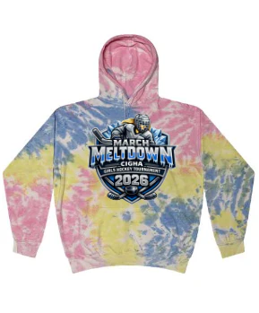


Apparel
https://tealowlboutique.com/collections

Slide 8

Bison Game Friday
(Women in Sports)
Players and coaches receive ONE FREE ticket with the purchase of a ticket — BOGO FREE! Yes, you read that right! This applies to all players and coaches attending March Meltdown.
This is also Women in Sports Night, and our goal is to PACK the arena with female hockey players! WEAR CIGHA gear!!
Central Illinois Girls Hockey Association - March Meltdown
Use code "CIGHA26" at checkout!
If you would like to order bulk team tickets please contact Jason Proot directly at: jproot@bloomingtonbisonhockey.com

Slide 9
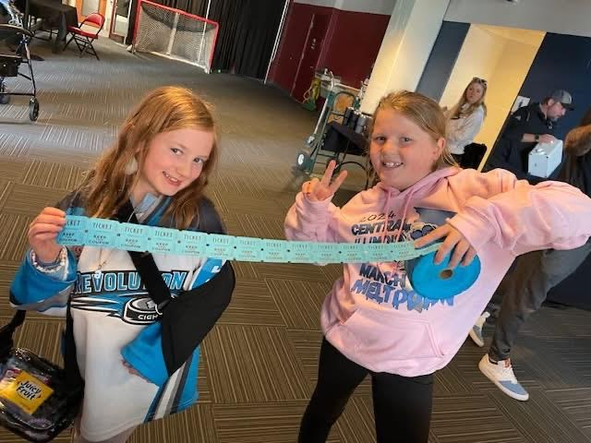
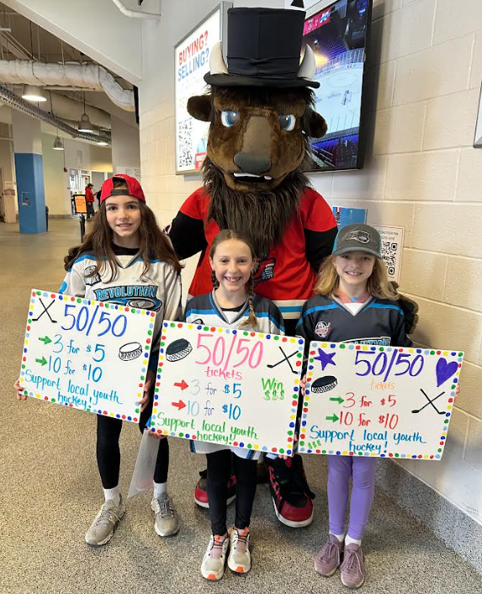
50/50 Sales at the Bison Game Friday
(Women in Sports)
Need 4 players and 4 parents to sell 50/50 tickets at this game 3-6-26
Contact Molly Sullivan to secure your spot!

Slide 10

SIGN UP:
https://www.signupgenius.com/go/904044FABA92FA5FC1-62394329-cigha

Slide 11
Board of Director Openings
Board Elections are coming up in April.
If you are interested in serving on our Board of Directors please fill out this application. We will be taking
applications until March 31st. 2026.
https://www.cigirlshockey.com/registration/61556
Natalie Rayfield, TIm Post and Sarah Clark will be vacating their positions at the end of March.
This leaves two member elected positions open. These positions are for 3yr terms.
There will also be a one year appointed term filled by an individual selected by the Board of Directors.
Remaining serving board members:
DOUG KENT - 1YRS REMAINING
KIELA MARTIN - 1YRS REMAINING
MOLLY SULLIVAN - 2YRS REMAINING
AUBREY WHITFIELD - 2YRS REMAINING

Slide 12


CIGHA Board of Directors

