Slide 1

STATE OF THE ASSOCIATION
2020 Annual Meeting of the Lakes Area Hockey Association

Slide 2
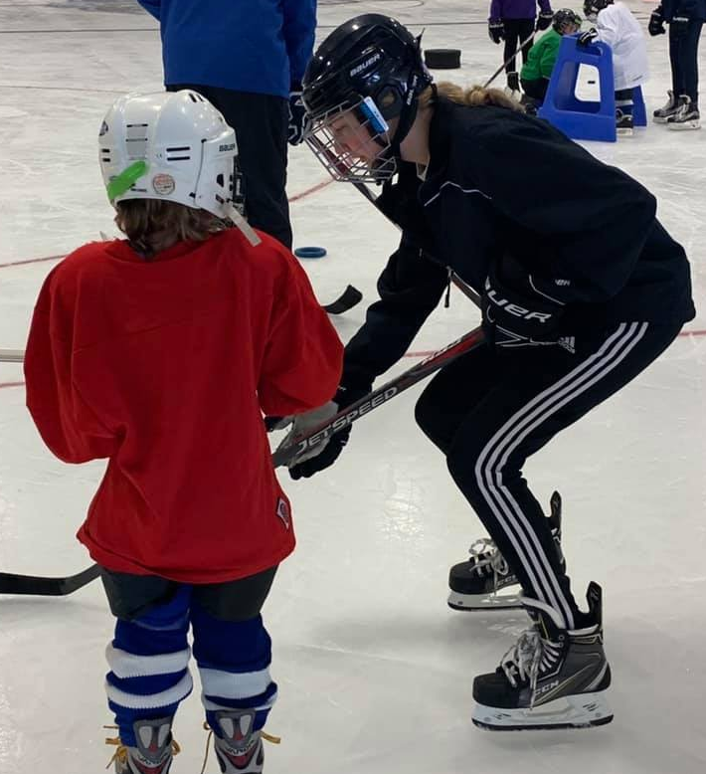
Financials
DEBT
$0K building
$0K new chiller
FUNDRAISING
$461K phase 3
$52K operating
Total Operating Revenue $204K
Total Operating Expenses $218K

Slide 3
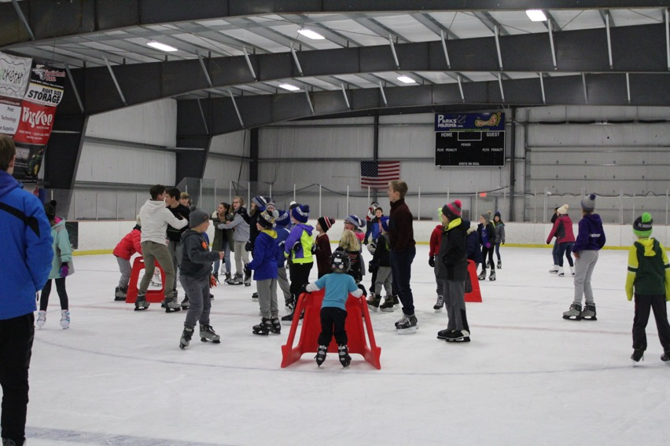
Open Skate
Hired staff helped bridge volunteer gap – cost $4,500
Sales $31K
3,766 Skaters
2,728 Skate Rentals
Average Sunday attendance 39

Slide 4
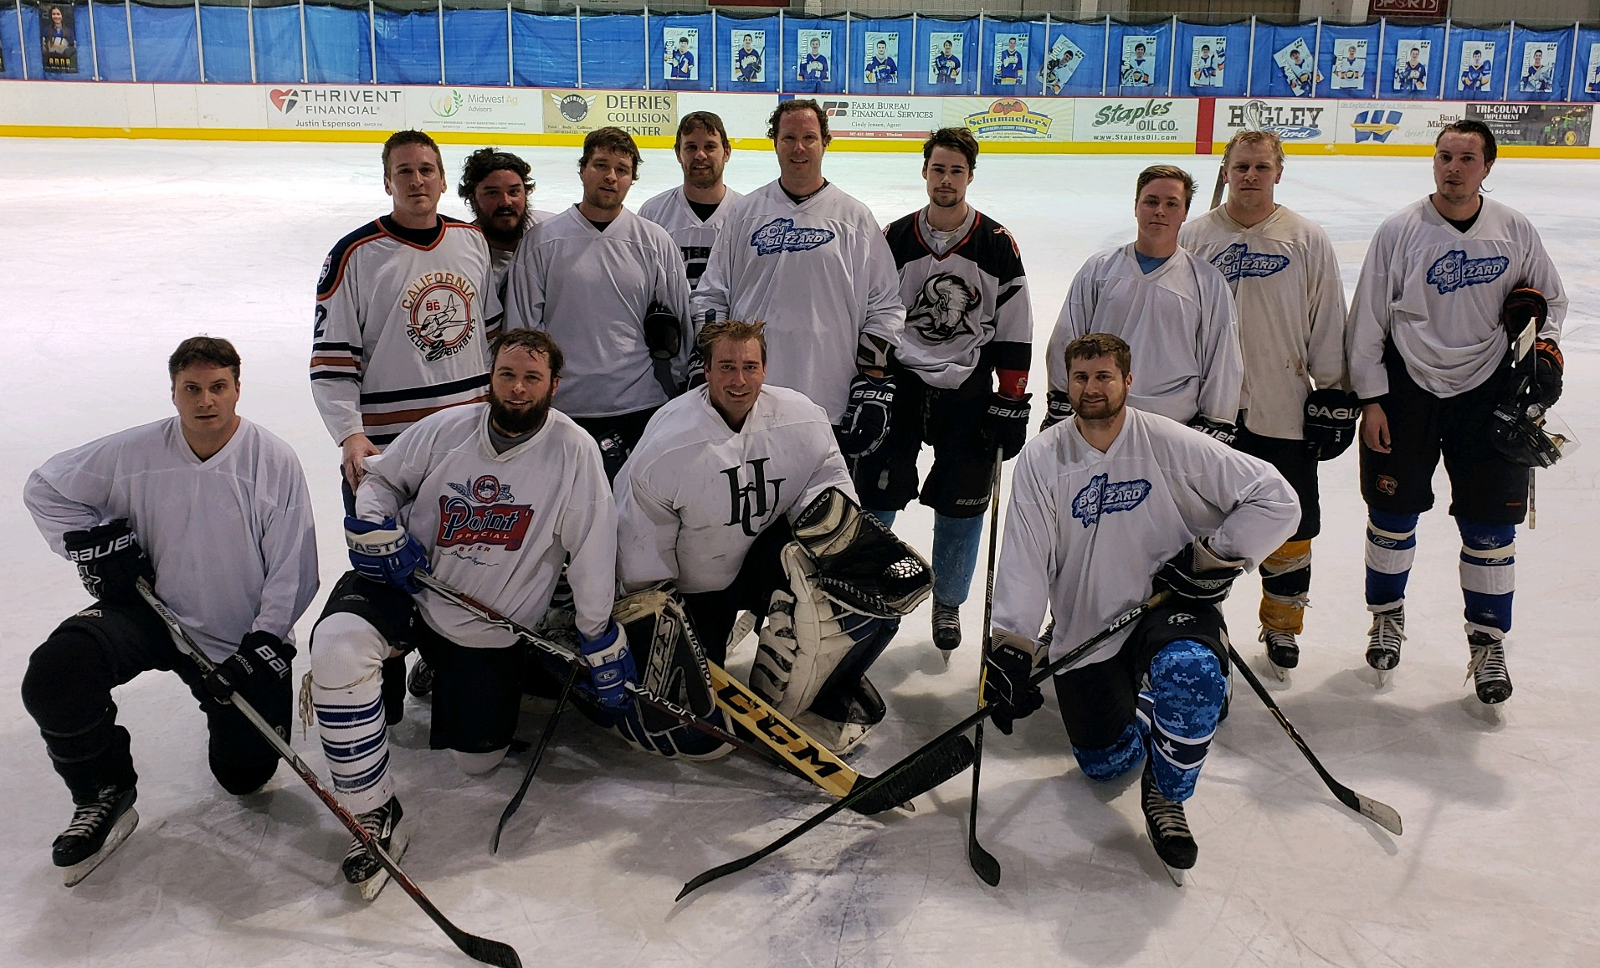
Hockey Season Stats
Travel program —107 players
Adult—Wednesday Nights—15-20 skaters
Hosted 5 tournaments
Hosted 16 Varsity & JV high school home games

Slide 5
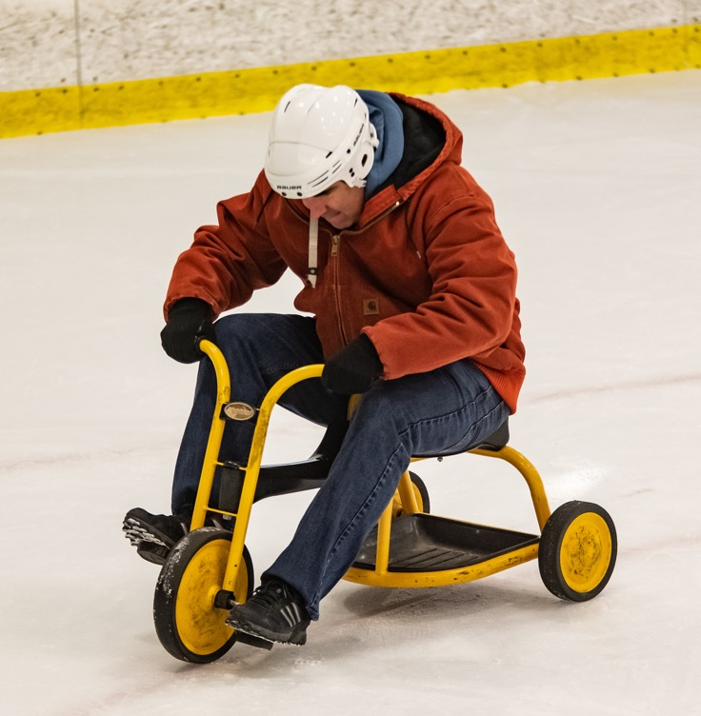
Tournament Season Stats
5 tournaments this season
$19,250 in registration income
Many returning teams
Offered onsite action photography at every tournament
Many fun events

Slide 6

Economic Impact on Our Community
220,000
Total estimated dollars spent in our community during this season
by families who came for
multi-day hockey events

Slide 7
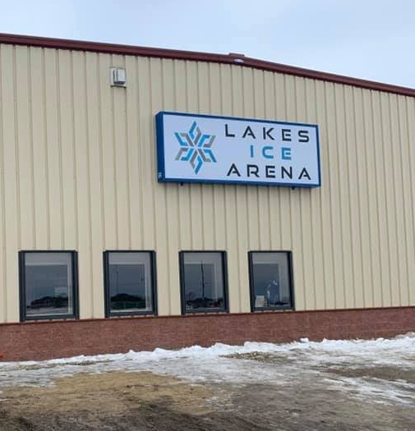
Accomplishments
  Hired Rink Manager
  Rebranded rink
  Built new public facing website & hockey focused website
  First season in Midwest High School Hockey League (MHSHL)
  Kicked off “Ask a Hockey Mom” program

Slide 8
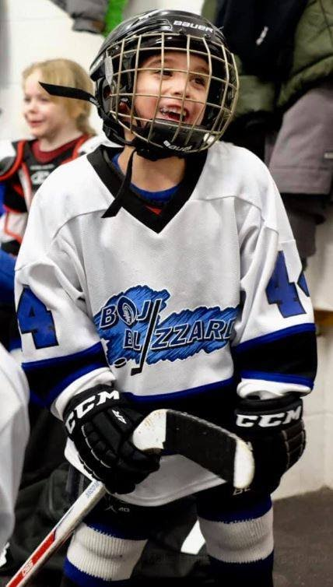
Items for 2020-21 Season
Phase 3 capital campaign and construction
Policies – review and compile
SafeSport changes – more detail to come
Volunteer hours analysis
Committee goals/responsibilities
Chiller committee

Slide 9
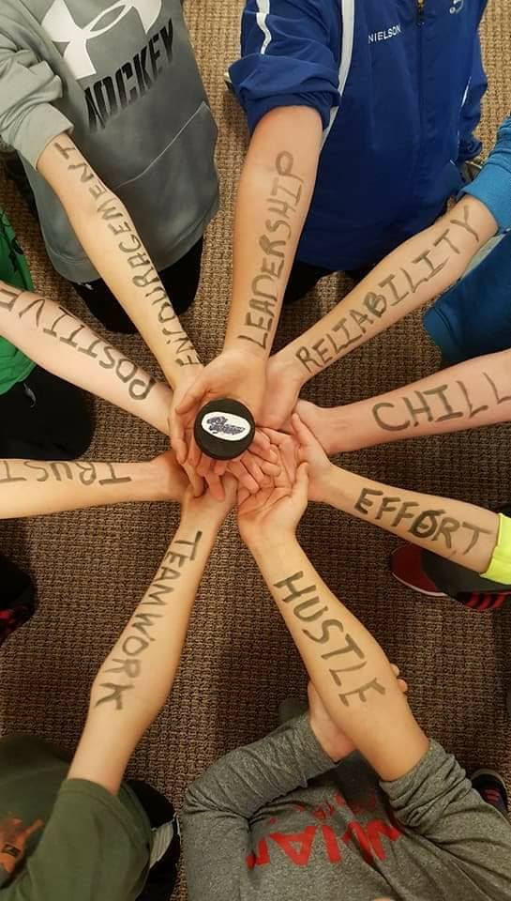

Why We Do What We Do

