Slide 1
Darien Lacrosse
Offensive Sets & Concepts
100 / 400 / 200 / SPREAD 200 /300 / 114

Slide 2
X
A1
D1
GLE
G
A3
D3
D2
A2
D4
Ally
M1
D5
D6
M3
M2
Point

Slide 3
Motion Offense-Objectives
Keep Field Balanced in Offense
Create Confusion for Defense
Creates Multiple Options for Pass, Shoot, Dodge
Give Flexibility to Offense
Create Mismatch Opportunities

Slide 4
Motion Offense-Sets
Other Terms
  X – Man behind the goal at position X
  Crease Man – Player in motion in front of goal or crease
  The Island – Area directly in front of goal/crease – refers to area extending about 6-8 yards from pipes, right to left. This is area where crease players will operate
  GLE – Goal Line Extended – refers to line extending out from the pipe of goal to sideline – wing attacks should be in front of goal line extended about 5-6 yards and off island

Slide 5
Motion Offense-Sets
Other Terms
  Spin it – refers to rapid movement of the ball around the perimeter (outside) of the offensive set
  Dodge – movement with ball to create space or separation from opponent designed to open up shot or pass, or force defense to slide creating opportunity to pressure the defense
  V-Cut or Pop – off ball movement to move towards a defender and rapidly away (in shape of V) to create separation and opportunity to receive pass

Slide 6
Motion Offense-Sets
Other Terms
  Circle C – cut around a pick, around defender or in crease to create space. Cut is made in shape of a C for quick open up looks
  Roll Back – a reverse direction of ball carrier if pass or dodge is blocked. Used to create separation from defender to reverse the ball direction quickly to the other side of the field.
  Ball side – referring to the side of the field ball is currently located
  Back side – referring to the opposite side of the offensive field the ball is on

Slide 7
Motion Offense-Sets
100 (1-3-2)
  Our sets are always counted starting behind the goal at X
  1 attack at X, 2 attack and 1 middie make up middle row, 2 middies make up top row
  To keep field balanced (2 middies always rotating to keep top row balanced and protect against transition

Slide 8
Motion Offense-Sets
100 (1-3-2) – What you will hear from coaches
  Set Call – 100
  Balance up (if we see open spots – we will call to balance up)
  Find Space (keep motion running, off ball movement to create and find open space which allows for passes, shots, dodges)
  Play with your eyes – see the field, get your head up and see the whole field, see the back side

Slide 9
A1
A3
A2
M1
M3
M2

Slide 10
A1
A3
A2
M1
The Island
M3
M2

Slide 11
Motion Offense-Sets
100 – Other Concepts and Rules
  Set Up – This offensive set creates 2 offensive triangles that work together to create motion and confuse the defense
  Ball movement in 100 – Move ball around perimeter
  Use V-Cuts to support the ball carrier and give open looks to pass
  Crease man is active and interchangeable with other middies and even attack in our 113 or X replace concepts

Slide 12
Motion Offense-Sets
100 – Other Concepts and Rules
  Rule 1 – ALWAYS maintain Field Balance
    Imagine a string connecting all the players in the triangle
    When one member of the triangle cuts through, the other players in that triangle MUST rotate and follow to maintain Field Balance
  Rule 2 – Rotate when the ball is passed from one triangle to the other
  Rule 3 – When one player dodges – BOTH triangles rotate (creates rapid motion and confusion forcing defense decisions to slide)

Slide 13
Motion Offense-Sets
100 – Other Concepts and Rules
  Rule 4 – Dodge – Pass – Pass – Dodge – If a player dodges, a good defense will slide to pick up the player – this is a good opportunity for two passes which will reverse the field and give the second receiver an opportunity to dodge and shoot. This is general rule but if the first dodge produces separation from defender and defense chooses NOT to slide – then shot may be open without additional passes

Slide 14
Motion Offense-Sets
400 (1-4-1)
  Our sets are always counted starting behind the goal at X
  1 attack at X, 2 attack and 2 middies make up middle row, 1 middie up top
  To keep field balanced (1 middie MUST always rotate to point to keep top balanced and protect against transition)
  In this set – if ball is lost – Attack MUST ride hard and aggressive all the way to midfield line to give other middies time to recover and shut down fast break

Slide 15
Motion Offense-Sets
400 (1-4-1) – What you will hear from coaches
  Set Call – 400
  Balance up (if we see open spots – we will call to balance up)
  Find Space (keep motion running, off ball movement to create and find open space which allows for passes, shots, dodges)
  Play with your eyes – see the field, get your head up and see the whole field, don’t forget to see the back side as well

Slide 16
A1
A3
A2
M3
M2
M1

Slide 17
A1
A3
A2
M3
M2
The Island
M1

Slide 18
Motion Offense-Sets
400 – Other Concepts and Rules
  Set Up – This offensive set creates a diamond perimeter with 2 crease players that uses picks, c cuts and movement around goal to confuse defense
  Ball movement in 400 – Move ball around perimeter
  Use V-Cuts to support the ball carrier and give open looks to pass – Receiver must create movement towards ball carrier to allow for shorter passes, then roll away from defense
  This offense set uses dodges to generate motion and get defense to react
  Many times in a 400 the open space will be created on the back side as a dodge pulls defenders to overload on one side leaving large spots of open space to the back side (This is why Dodge, Pass, Pass, Dodge works so effectively in a 400)

Slide 19
Motion Offense-Sets
400 – Other Concepts and Rules
  Rule 1 – ALWAYS maintain Field Balance
  Rule 2 – Attack MUST ride hard and tight if possession is lost to give time for downfield middies to recover and shut off fast break
  Rule 3 – When one player dodges – BOTH triangles rotate (creates rapid motion and confusion forcing defense decisions to slide)

Slide 20
Motion Offense-Sets
400 – Other Concepts and Rules
  Rule 4 – Dodge – Pass – Pass – Dodge – If a player dodges, a good defense will slide to pick up the player – this is a good opportunity for two passes which will reverse the field and give the second receiver an opportunity to dodge and shoot or look for feed. This is general rule but if the first dodge produces separation from defender and defense chooses NOT to slide – then shot may be open without additional passes

Slide 21
Motion Offense-Sets
400 – Other Concepts and Rules
  Rule 5 – Many times the best initial dodges in this offense set come from X or Top Middie. Always dodge towards center and then down the ally towards the pipe (NOT down the sideline)

Slide 22
Motion Offense-Sets
200 (2-2-2)
  Our sets are always counted starting behind the goal at X
  2 attack behind goal-corners, 1 attack and 1 middie on island, 2 middies up top at corners or on wings if in a spread 200 look
  To keep field balanced (rotate on dodges)

Slide 23
Motion Offense-Sets
200 (2-2-2) – What you will hear from coaches
  Set Call – 200
  Balance up (if we see open spots – we will call to balance up)
  Find Space (keep motion running, off ball movement to create and find open space which allows for passes, shots, dodges)
  Play with your eyes – see the field, get your head up and see the whole field, don’t forget to see the back side as well

Slide 24
A3
A1
A2
M3
M1
M2

Slide 25
A3
A1
A2
M3
The Island
M1
M2

Slide 26
Motion Offense-Sets
200 – Other Concepts and Rules
  Set Up – This offensive set creates a Box perimeter with 2 crease players that uses picks, stack formations, and movement on the island to confuse defense
  Ball movement in 200 – Move ball around perimeter – in this formation the passes are longer so it is critical that you move towards each other when passing and receiving to gain separation from defense
  Use V-Cuts to support the ball carrier and give open looks to pass – Receiver must create movement towards ball carrier to allow for shorter passes, then roll away from defense
  This offense set uses dodges, picks, rolls to generate motion and get defense to react – objective to use dodges from the corners to force a crease slide and move defense out of the crease
  This creates fantastic opportunity for quick passes to reverse field or roll back opportunities to get defense to overload and open up back side looks

Slide 27
Motion Offense-Sets
Spread 200– Pairs 2 man game
  Rule 1 – ALWAYS maintain Field Balance
  Rule 2 – Use dodges to start motion
  Rule 3 – When one player dodges – Player partnering with ball carrier clears through and/or sets pick
  Rule 4 – Off the pick – dodger looks to attack goal and force slide, other players are in pairs and always work to occupy their defender by constant switching with each other.

Slide 28
A3
A1
A2
M3
M1
M2

Slide 29
Offensive Playbook
2025

Slide 30
100 Offense

Slide 31
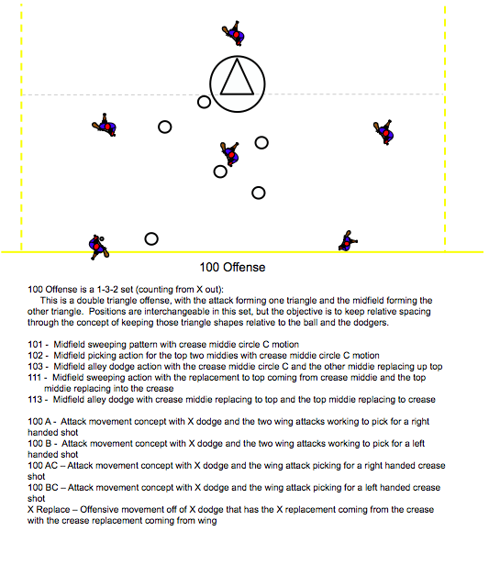

Slide 32
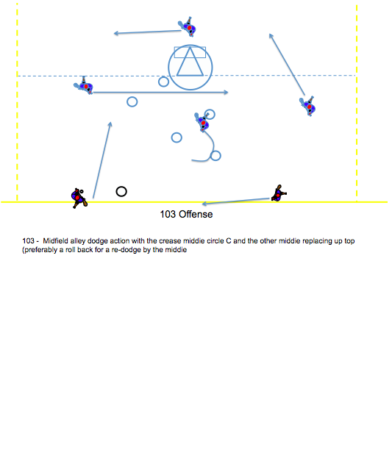

Slide 33
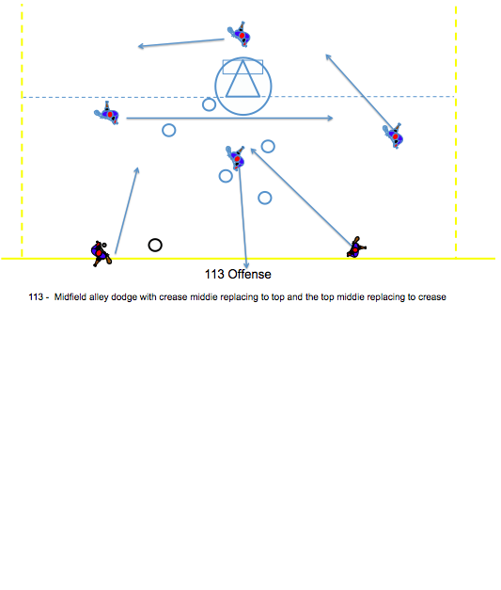

Slide 34
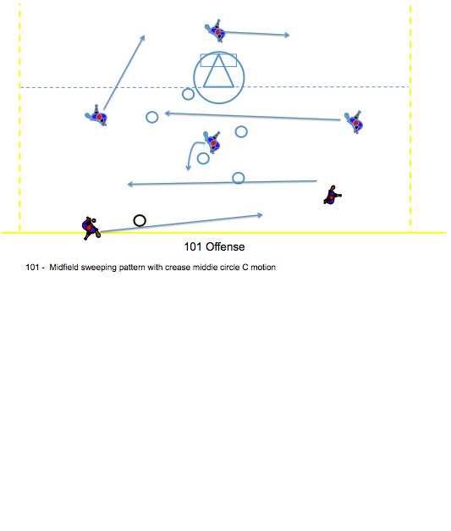

Slide 35
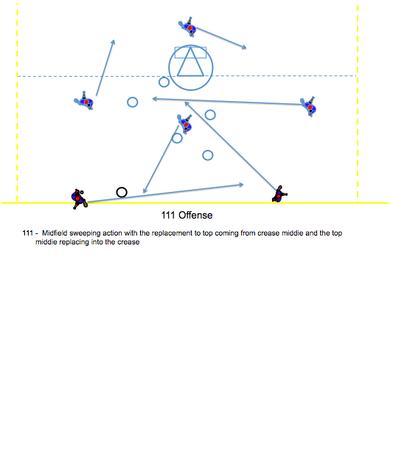

Slide 36
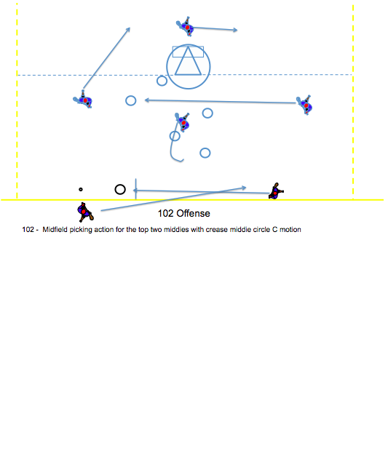

Slide 37
.
100 A

Slide 38
.
100 B

Slide 39
.
100 AC

Slide 40
.
100 BC

Slide 41
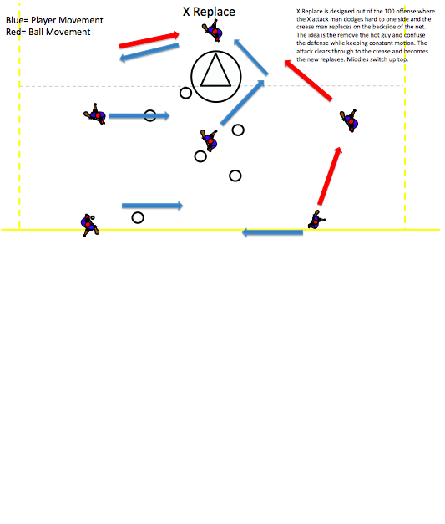

Slide 42
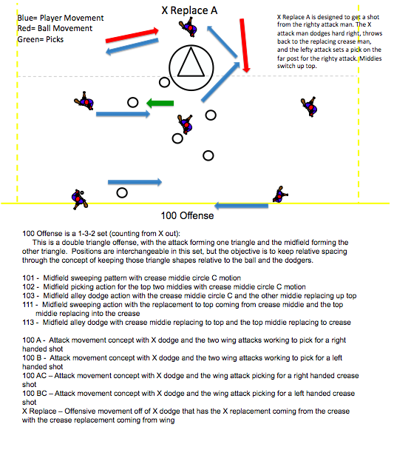

Slide 43
Spread 200 Offense
TIGER & Duke Motion Concepts

Slide 44
Duke Motion

Slide 45
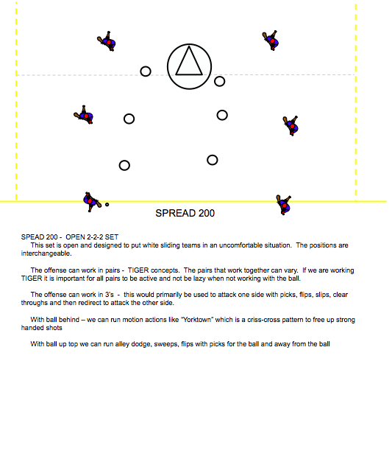

Slide 46
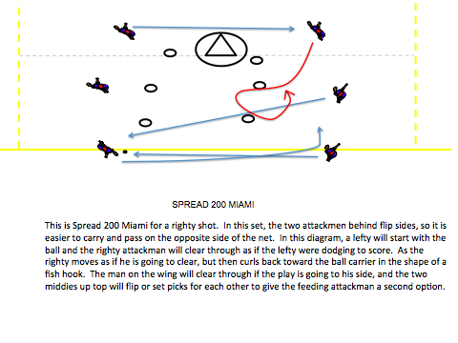

Slide 47
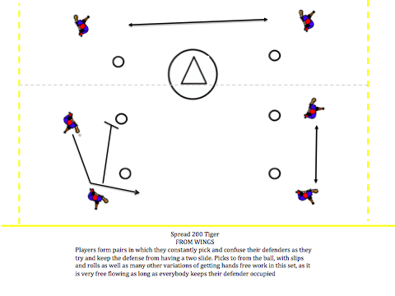

Slide 48
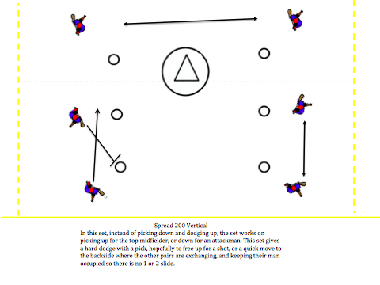

Slide 49
300 Offense

Slide 50
300 Offense
300 Offense – 2-1-3 Set (counting from X)
Attack forms a triangle with a crease attack
Midfield forms an umbrella shape with middies interchangeable
With ball at the attack – the crease attack stays high and reads the slide hoping for a backdoor cut behind slide to dodging attack. Middies keep a constant movement concept going to not allow for a “2” on the crease attack. They must read their man and decide when a possible backdoor cut or front side swing cut is possible – DO NOT CLOG THE CREASE OR GET TO LOW!
With ball in the midfield – there are weave options, flip options, sweep options, pick options, alley dodge from off set alignment. The attack can keep a constant flow option or can remain in the triangle shape for outlet and circle C crease pattern

Slide 51
300 Weave
Middies in constant motion, using picks, flips, and clear trough's with adjacent player in order to create confusing switches for the defense .

Slide 52
303
303 is a hard alley dodge with the other middies shifting to the left for a right alley dodge and vice versa for a lefty dodge. The aim is to draw a slide from the crease. If there is no shot right away quickly pass it to X where the attackman can then work the ball to the backside for a redodge. After the middie finishes his dodge he replaces back up top.

Slide 53
400 Offense

Slide 54
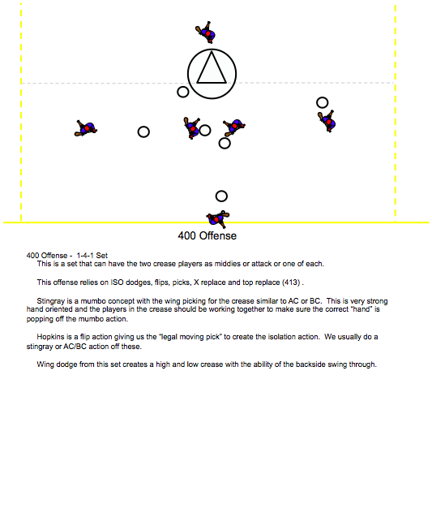

Slide 55
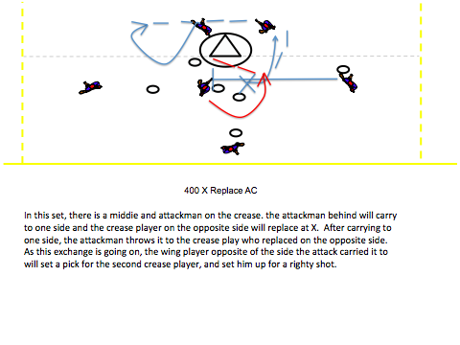

Slide 56
400 Offense
400 Offense - 1-4-1 Set
This is a set that can have the two crease players as middies or attack or one of each.
This offense relies on ISO dodges, flips, picks, X replace and top replace (413) .
Stingray is a mumbo concept with the wing picking for the crease similar to AC or BC. This is very strong hand oriented and the players in the crease should be working together to make sure the correct “hand” is popping off the mumbo action.
Hopkins is a flip action giving us the “legal moving pick” to create the isolation action. We usually do a stingray or AC/BC action off these.
Wing dodge from this set creates a high and low crease with the ability of the backside swing through.

Slide 57
413:

Slide 58
Middie up top initiates the dodge down the alley (Either direction).
413:

Slide 59
Depending on the direction of the dodge, the two crease players must communicate to decide who replaces up top.
413:

Slide 60
The player that stays inside performs a “circle C” to be an option for the dodger.
413:

Slide 61
The dodger has the option to shoot, pass inside, or redirect the ball up top.
413:

Slide 62
400 Hopkins Stingray:

Slide 63
Middie up top initiates the dodge
(Either direction UNLESS otherwise specified)
400 Hopkins Stingray:

Slide 64
The wing player motions behind the dodging middie to receives the flip.
400 Hopkins Stingray:

Slide 65
T
Meanwhile, the opposite wing player crashes the crease to set a pick for the man inside.
400 Hopkins Stingray:

Slide 66
The inside player does a “circle C” off of the pick to receive a pass from the ball carrier.
T
400 Hopkins Stingray:

Slide 67
The middie who initiated the dodge continues downfield while the wing player accelerates into the redirecting dodge.
This will provide the wing dodger momentum over the trailing defender(s).
T
400 Hopkins Stingray:

Slide 68
T
The ball carrier now passes the ball to the open man on the wing for the shot.
400 Hopkins Stingray:

Slide 69
T
The ball carrier now passes the ball to the open man on the wing.
However, if the defense identifies the pick, the dodger has the option to shoot if he has the space.
400 Hopkins Stingray:

Slide 70
400 Stingray:

Slide 71
Middie up top initiates the dodge
(Either direction)
400 Stingray:

Slide 72
T
T
Meanwhile, the wing players crash the crease to set picks for the players inside.
400 Stingray:

Slide 73
T
T
The crease players “circle C” off of the picks, leaving their defenders inside.
400 Stingray:

Slide 74
T
T
The dodger now has 3 options. Shoot, pass right, or pass left (each for the shot).
400 Stingray:

Slide 75
1-1-4 Offense

Slide 76
1-1-4
Midfielders cross and can set picks for each other in order to get an outside shot.
X-Attack dodges to one side and looks to feed while the crease attack slips off to the backside.
1-1-4 Yorktown

Slide 77
1-1-4
Wing players come in and set picks for the crease players. (Circle C cut)
Crease player looks to catch and finish but replaces X-Attack
1-1-4 Invert Stingray

Slide 78
Ready List
100
100 series: 101,102,103,111,113
400 series: stingray, invert stingray, HOPKINS TO STINGRAY, HOPKINS TO AC or BC this is between wing & X
413 & 400 X REPLACE & 41 SHORT
SPREAD 200 – Tiger, Tiger Low , Top Side, vertical 2, Miami
42 TIGER - also get to this out of Tiger Low
24 Stack & 24 SHORT Stack: can use NAVY, YORKTOWN TOO
Duke Motion
200 OR 300 – BIG & SHORT - EDGE, NAVY & YORKTOWN
24 Motion
YORKTOWN’S 1-1-2-2 A & B
YORKTOWN 1-1-0-4 NAVY & X REPLACE or EDGE to NAVY
TIGER: 300 / 400

Slide 79
Ready List: Part II
CALL PLAYS:
100 A, B, AC, BC, / A, B, AC OR BC DIRECT / EDGE
Army = 100 A Brown = 100 B Navy = Stingray Colgate = AC / 100 DOUBLE TO STINGRAY / 100 FLIP/PICK STINGRAY
100 X REPLACE A OR B / 100 X REPLACE DARTMOUTH OR YORTOWN
400 STINGRAY, X REPLACE AC OR BC, INVERT STINGRAY, X REPLACE DOUBLE A OR B
41 SHORT: STACK / AC/BC
200 A or B, 203 to AC/B
HOPKINS (FLIPS) OUT OF ALL SETS / TIGER OUT OF ALL SETS
SPREAD 200 - Tiger Offense
Pairs – Left & Right Pairs
VERTICAL TWO or THREE
Army & Brown from Tiger Pairs
201 or 202 Dartmouth Reverse
MIAMI

Slide 80
Ready List: Part III
ZONE OFFENSE / EMO OFFENSE
CAROLINA / CAROLINA BINGO
CAROLINA A OR B (CREASE ATTACK IS WALLING OFF THE BACKSIDE SLIDE)
24 STACK
CAROLINA X REPLACE TO SPREAD 200: DARTMOUTH / DARTMOUTH REVERSE / YORKTOWN
LOYOLA / LOYOLA X BINGO TO DARTMOUTH
LOYOLA BINGO TO CAROLINA
HOUSE / HOUSE BINGO / HIGH HOUSE BINGO
200 DUKE MOTION / DUKE SPLIT MOTION
400 X REPLACE / AC-BC
400 X REPLACE TO MARYLAND – “2-3-1”
SPREAD 200 PUSH
413
300 OR 100 TO X REPLACE = SPREAD 200 – PRINCETON = DOUBLE PICK

