Slide 1
Working Boats On The Cuyahoga River

Slide 2
FREIGHTERS
Algoma Buffalo
American Courage
Calumet
Cuyahoga
Herbert Jackson
Joseph H. Thompson
Manitowoc
Mark Barker
New Work
Pathfinder
St. Mary’s Cement
Sam Laud
Van Wert (pusher tug name?)
Wilfred Sykes

Slide 3
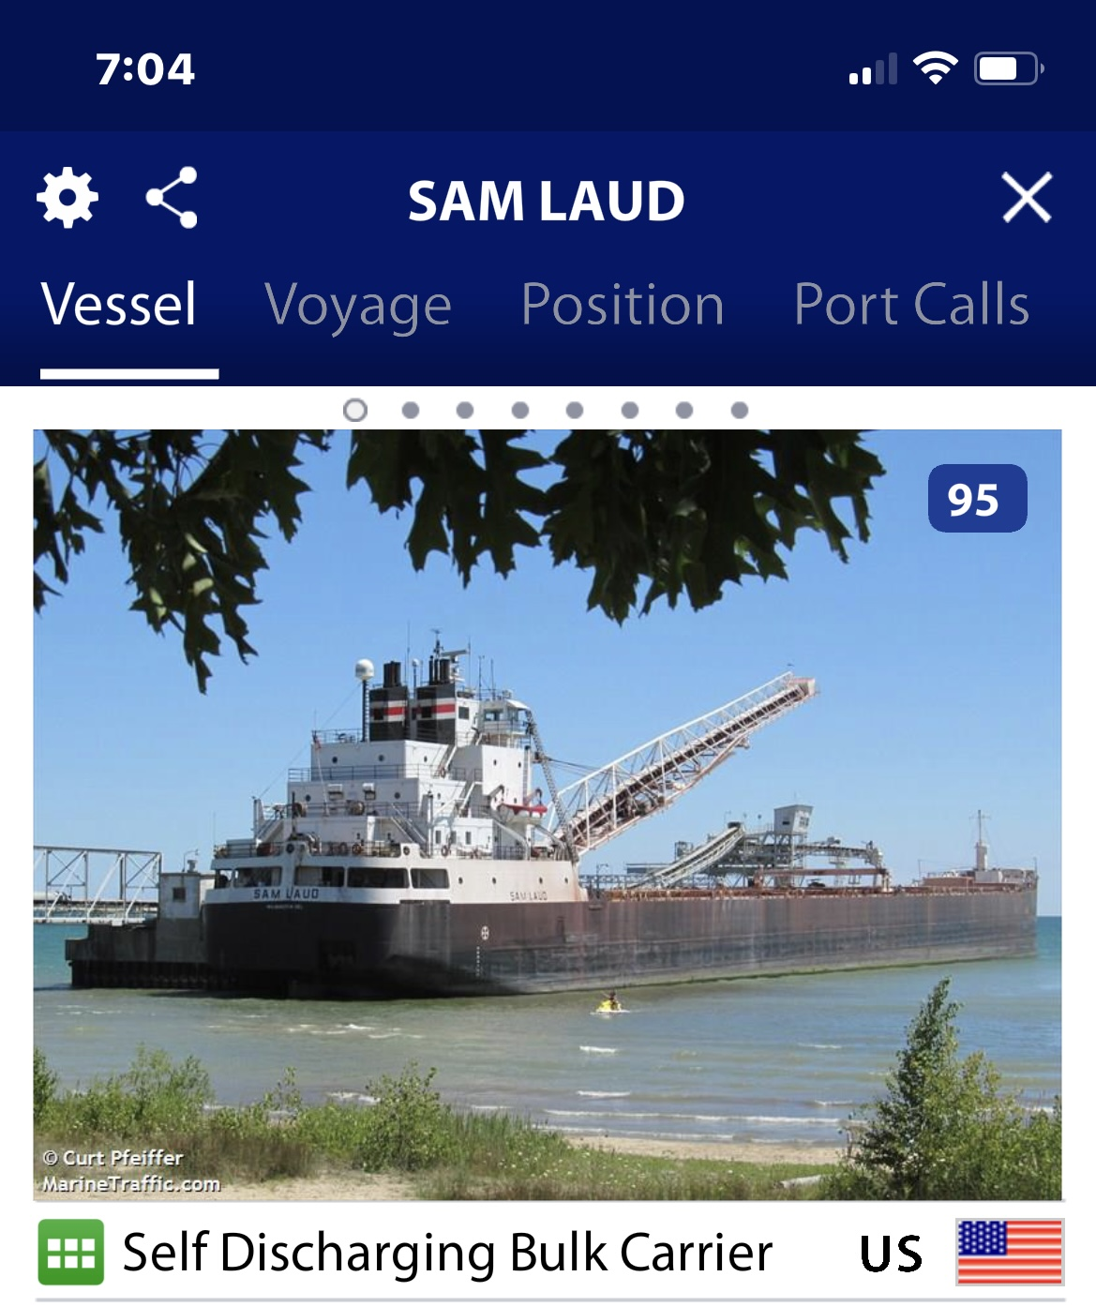
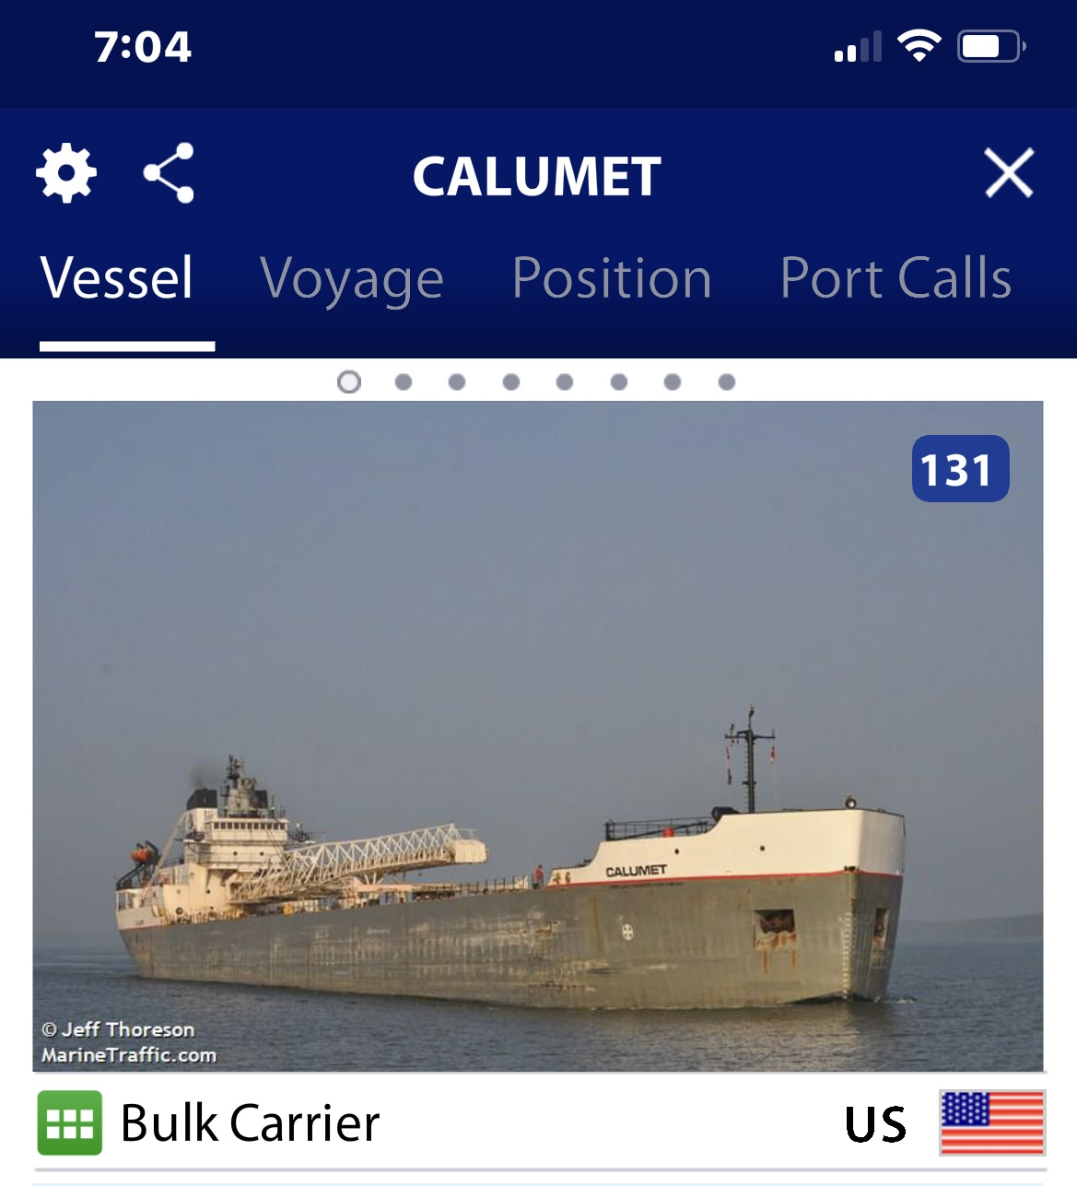
Sam Laud & Calumet

Slide 4
Marine Traffic App
Photos on previous slide are screen shots from the Marine Traffic App
Note the name of the vessel in the top banner AND the type of vessel below the photograph. In this case a Self Discharging Bulk Carrier.
This is an extremely useful app as it will allow you to track location of freighters, tugs, and barges.
Strongly encourage all scullers to download to phone.

Slide 5
Freighters with Dedicated Pusher Tug
Joseph H. Thompson (freighter) with Laura L. Van Enkevort (pusher tug)
Pathfinder (freighter) with Dorothy Ann (pusher tug)
St. Mary Cement (freighter) with Petit Forte OR Dorothy Ann (both pusher tugs)
St. Mary’s Challenger (sometimes parks upstream of Foundry)
Many Freighters are self discharging and typically do not need a tug.

Slide 6
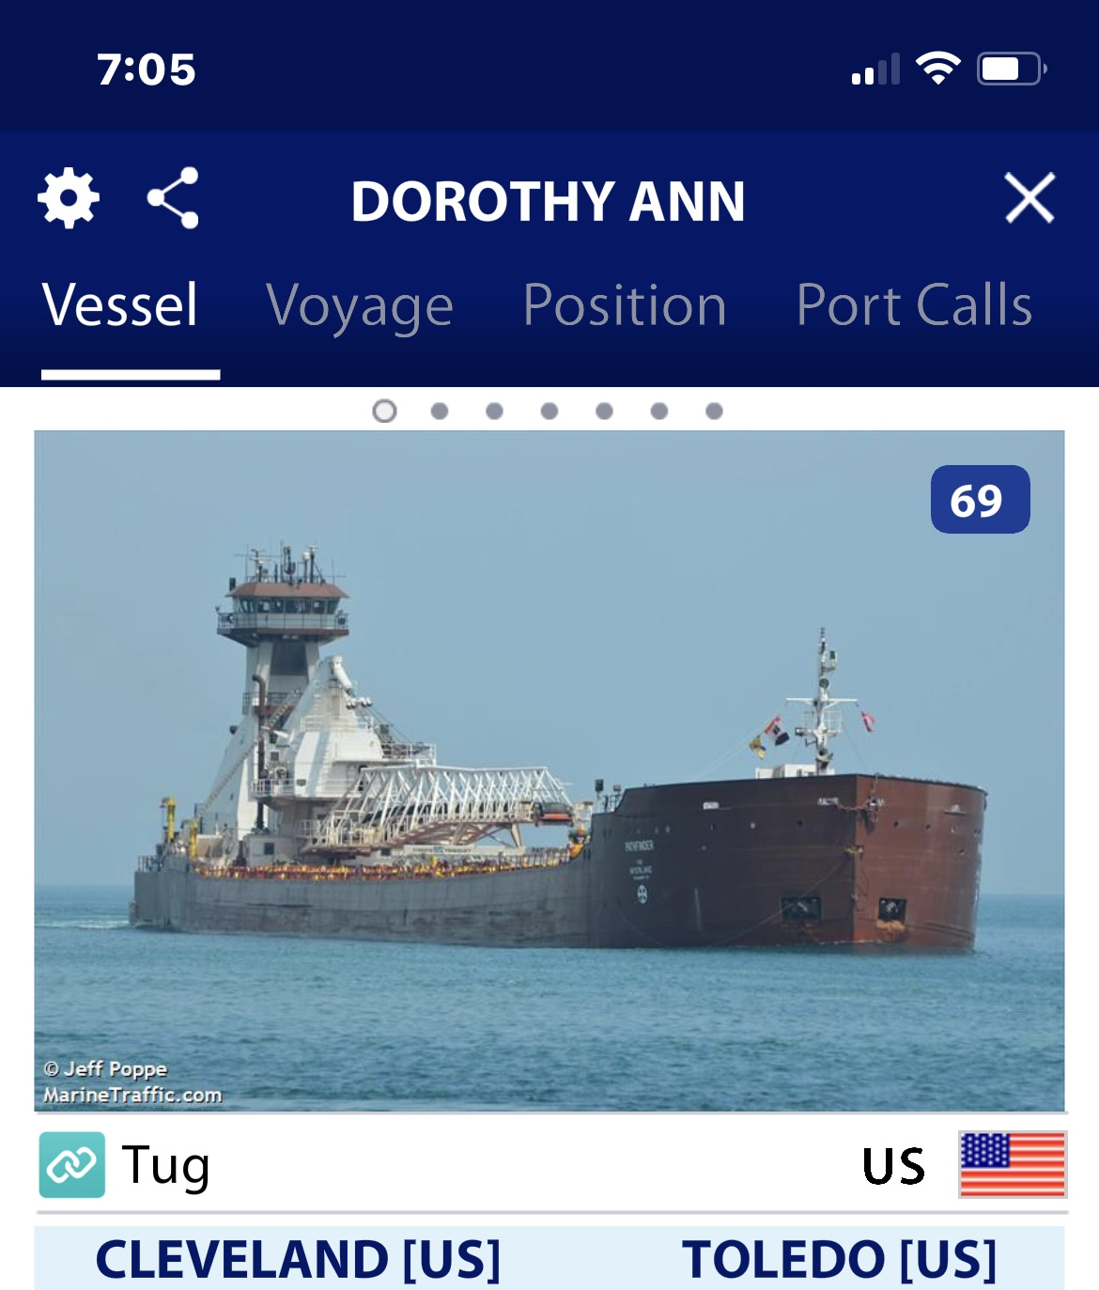
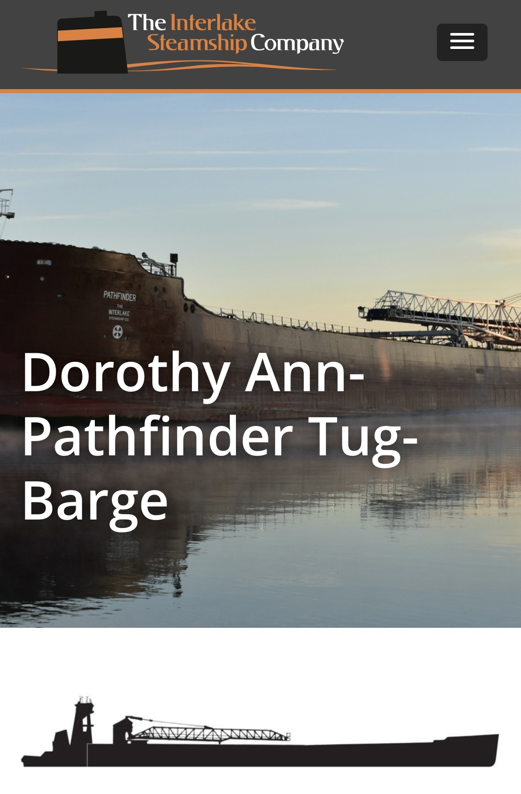
Dorothy Ann – Pathfinder
Tug-Barge Combo

Slide 7
Tugs
Annabell Strong
Eagle
Illinois
Iowa
Moby Dick/George Gradel
Ohio
Mississippi
Pennsylvania
Sea Eagle II (pusher tug)
Wisconsin

Slide 8
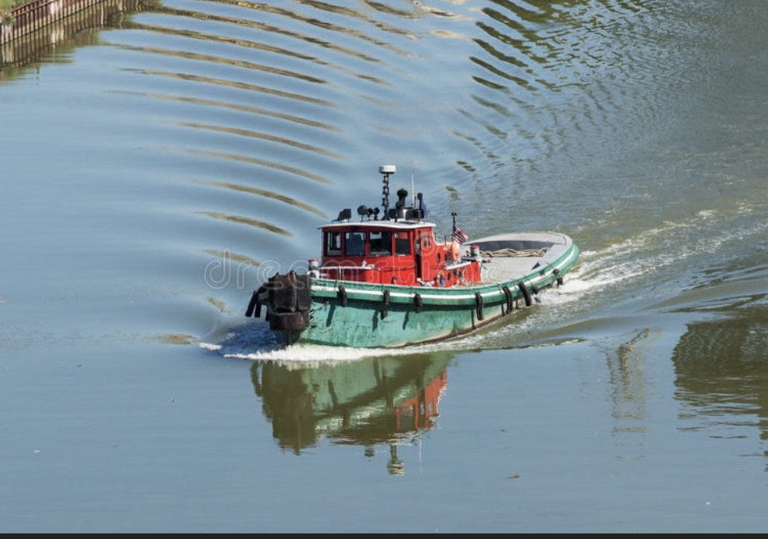
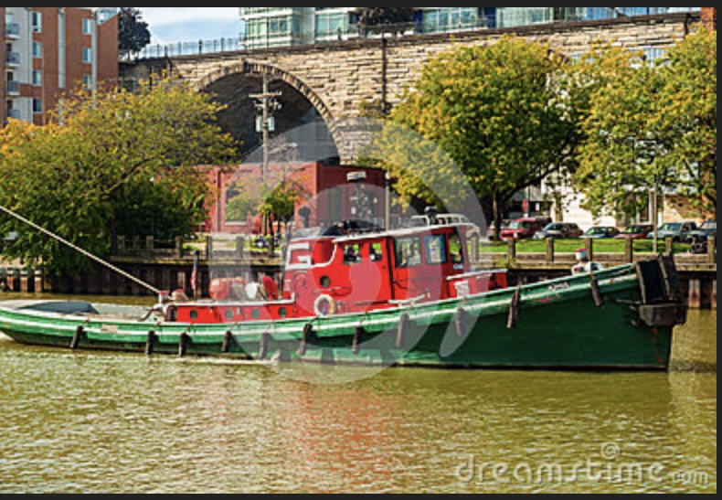
Great Lakes Towing Tugs

Slide 9
Dredge Barges
Kathy Lynn
Thomas Moorish – moves fast

Slide 10
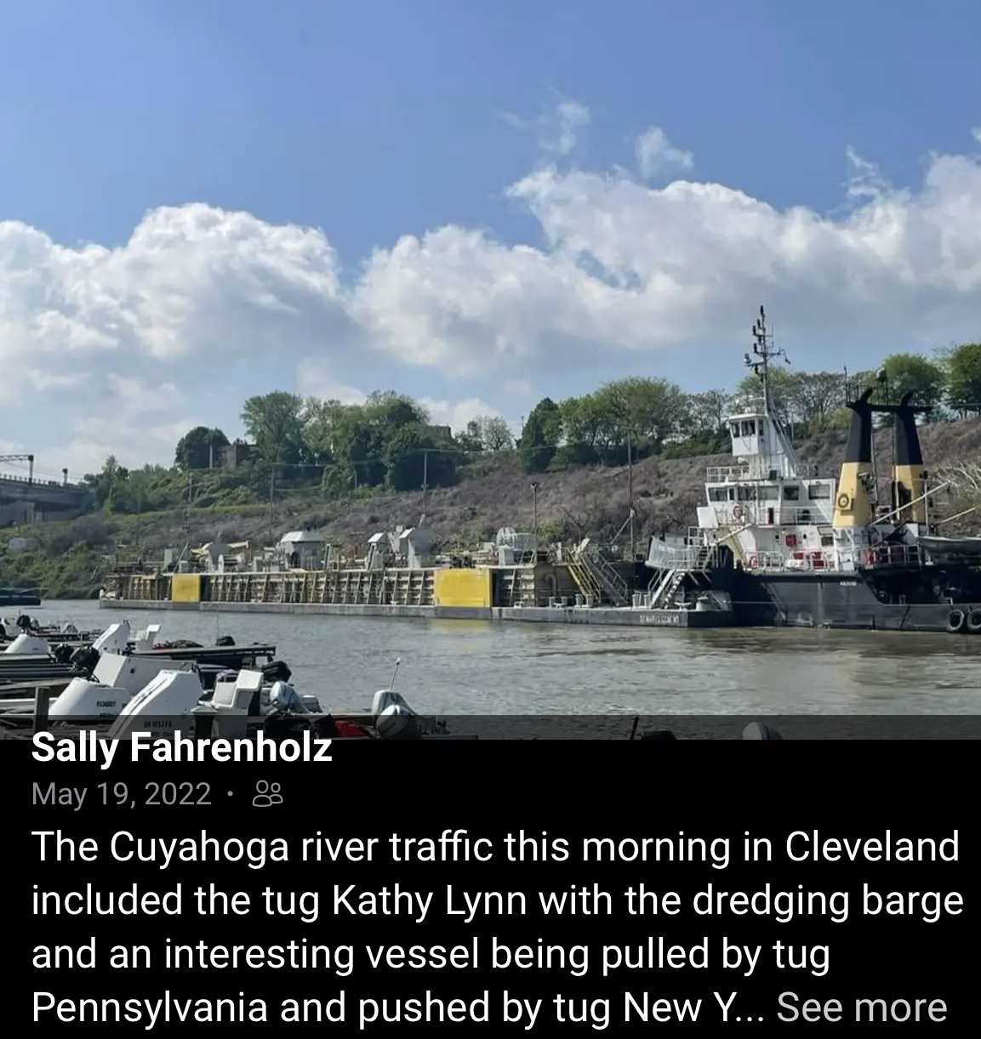
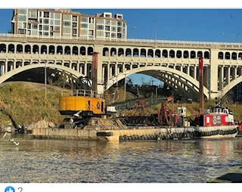
Tugs with Barges
Grace O’Malley and Kathy Lynn

Slide 11
Miscellaneous Vessels
Holiday – fishing boat moored by Fire Station. Will go under high sides of Carter and Columbus to avoid bridge lift.
Sea Eagle – smaller boat typically moored on west side of river by turning basin.

