Slide 1
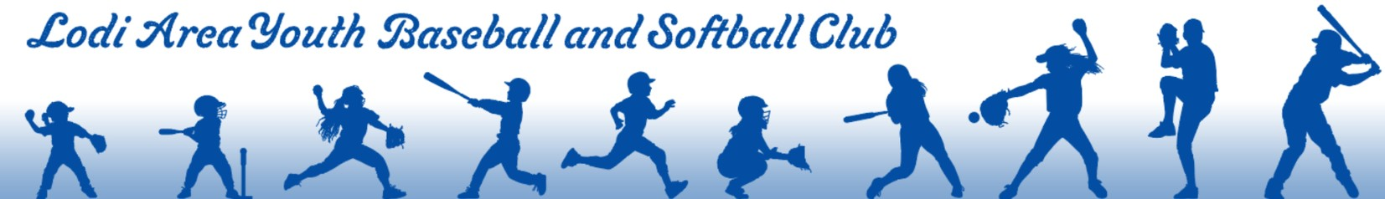

LAYBS Umpire Training

Slide 2
Training Goal
This self paced training provides building knowledge around the basics of umpiring for youth baseball and softball. The training is built to develop new umpires of all ages in being successful in their umpire role.

Slide 3
Training Scope
Umpire Equipment
Basic Umpiring Knowledge
Sportsmanship – Game Culture
Conflict Resolution

Slide 4
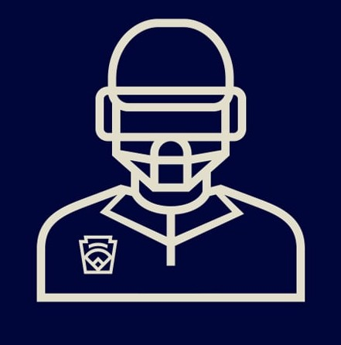
Umpire Equipment

Slide 5
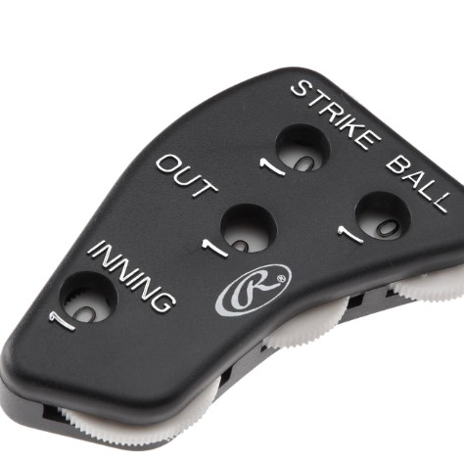
Umpire Equipment
Home Plate Umpire
  Facemask and chest protector (These will be provided in storage sheds at the ball fields)
  Umpire Clicker (Ball, strike, number of outs counter) and plate brush.
    A set will be provided in storage sheds at the ball fields. It is encouraged, but not required, to bring your own clicker. In the event a prior umpire misplaces the provided one. These can be affordably purchased at majority of sport stores or online.
Field Umpire
  Umpire Clicker (Ball, strike, number of outs counter)
    One will be provided in storage sheds at the ball fields. It is encouraged, but not required, to bring your own clicker. In the event it is already being used, or a prior umpire misplaces the provided one. These can be affordably purchased at majority of sport stores or online.

Slide 6
Basic Umpire Knowledge – Behind the Plate Umpire

Slide 7
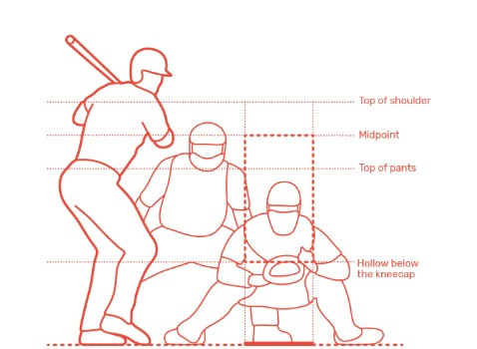
The STRIKE Zone
Zone ranges from the top of a batter’s shoulders to the batter’s kneecaps.
With youth age levels, please be sure to communicate with the coaches before the start of the game as to how lenient of the strike zone they agree upon (especially for the younger ages with beginner pitchers.) For example: at 10U level, pitches at eye level may be agreed upon as acceptable due to the beginner pitchers learning to find the strike zone.

Slide 8

Called STRIKE Mechanic
Stand up out of your stance
Raise your right hand so your elbow is parallel to the ground
In a "hammer" motion, move your forearm forward while closing your fist
Say "Strike" in a loud voice
Drop your arm to your side, take a step back, and relax
Click below for video reference of this mechanic
https://www.youtube.com/watch?v=48urjqoth64

Slide 9
Called BALL Mechanic
Verbalize by saying loudly “Ball”. No arm motions are required.

Slide 10

Summary of Called STRIKE/BALL Mechanic
Click the video below to reference these mechanics
https://www.youtube.com/watch?v=CA7J0P9DvLQ

Slide 11
Foul Ball Mechanic
When a batted ball hits the batter in the batter’s box or is not caught by a defensive player.
  A FOUL ball is tracked as a counted STRIKE unless the batter has 2 STRIKES on their count. Additional FOUL ball with a 2 strike count, will remain as a called FOUL BALL with no BALLS or STRIKES added to the count. This will continue until the batter strikes out watching a pitched strike, swinging and missing a pitched ball or a batted ball is put into play/an out is made on the batter.
Click below for video reference of this mechanic
https://www.youtube.com/watch?v=pJTAQp45rm4

Slide 12
Basic Umpire Knowledge – Base/Field Umpire

Slide 13
Player is SAFE or OUT Call and Ump Position
A SAFE call is made when a player is deemed as SAFE on a base. (no play is made on the base, or the baseman dropped the ball with no possession)
An OUT call is made when a player is deemed as OUT. (play is made on the base and the baseman has secured possession of the ball)
LAYBS uses either 1 umpire (plate umpire) or 2 umpires (plate umpire and field umpire). LAYBS Field umpires focus on umpire positions A, B and C position ONLY.
Click below for video reference of this mechanic
https://www.youtube.com/watch?v=fJzYSgIEa_s

Slide 14

Game Culture
Instilling Good Sportsmanship

Slide 15
Sportsmanship and Umpire Game Culture
Umpires are responsible for enforcing rules and making judgement calls. This includes setting sportsmanship and game culture expectations.
  Create a positive environment and encourage positive attitudes.
  Communicate to Coaches and Players about fostering good sportsmanship (LAYBS is a youth developmental program and encourages respectful and fun game culture.)
  Encourage positive handshakes by both teams and coaches at the finish of the game.
  Disrespectful and unsportsmanlike behavior is NOT allowed and will not be tolerated.

Slide 16

Conflict Resolution
Navigating Communication

Slide 17
Navigating play call conflict
Umpires shall be confident in their calls and be respected by all game participants (athletes, coaches and spectators.)
In the event of a disagreement with an umpire call:
  If there are 2 umpires, the umpires may consult with each other making the best call for the situation.
    Do not allow coaches, athletes or spectators to influence your umpire call. Your call decision must be unbiased and to the best of your ability. Learn and develop from any play call situation. Not all situations are alike.
  Educate the coaches/athletes on your play call.
    Encourage questions and provide thoughtful responses.
  Focus on solutions (communicate calmly)
LAYBS has ZERO tolerance for yelling, screaming are disrespectfully arguing with Umpires by Coaches, Athletes or Spectators. This can result in ejection from the game/field.
PLEASE REPORT ANY UNACCEPTABLE BEHAVIOR TO LAYBS DIRECTOR OF OFFICIATING OR LAYBS BOARD MEMBERS IF SUCH EVENTS OCCUR.

Slide 18

HAVE FUN!
LAYBS fosters a positive environment with the focus on development for youth baseball and softball athletes!

Slide 19
Thank you for your interest in being an Umpire!
Please direct any umpire questions to the LAYBS Director of Officiating
officiating@laybs.org

